Slide 1
Introduction
SVZ Technologies, LLC was founded in 2005 as for profit engineering consulting and technology development company, with a primary focus on research and development of semiconductor applied optoelectronic devices and related technologies.
SVZ Technologies is focused on fulfilling commercial orders and building own IP, and it was four times winner of the competitive bid for supply of the scientific equipment for NATO research programs, including two times in the last two years. Corresponding devices and technologies were successfully designed and manufactured to the specs and became commercial products of the company.
SVZ Technologies expertise is semiconductor optoelectronics and technology. The company focuses on advanced compound semiconductors like indium phosphide and gallium nitride, as well as on infrared materials and devices. Our consulting projects cover mask design, wafer etching (wet and dry), vacuum coating, wafer bonding, dicing, wafer cleaving and testing (both material and device testing). Most of technologies and devices developed by the company are related to lasers and photo diodes based on compound semiconductor heterostructures grown by MBE and MOCVD technologies.
SVZ Technologies applied devices have modern design and include custom analog and digital electronics, software, mechanics and optics to support our unique optoelectronic units.

Slide 2
Management
Dr. Zaitsev has more than 30 years of experience in semiconductor optoelectronics design. He has published over 130 papers and communications in this field. In 2001 he was elected as Photonics/IEEE Senior Member for his distinguished achievements in the development of advanced diode lasers. After finishing his academic career, he works in the US optoelectronics industry. Prior to establishing SVZ Technologies, Dr. Zaitsev served as Principal Investigator in multiple programs sponsored by such agencies as NASA, DARPA, US Navy, U.S. Air Force, MDA, DOE, etc. As Principal Scientist, he supervised commercial projects related to fiber optical communications and development of advanced semiconductor materials. His expertise covers visible and infrared optics, optoelectronics, medical and metric devices, compound semiconductors, technologies and modern processing equipment for the semiconductor industry.

Slide 3
What problems are we trying to solve?
We propose novel patented device to fill the gap between telescopic sights and thermal sights.
There is high demand for thermal scopes in both military and civilian applications. They are efficient, however, they have certain limitations:
Very high price: the scope is much more expensive than a typical rifle.
Weight: thermal scopes may weigh up to 3 lb.
High power consumption: it limits operation time and requires bulky spare batteries.
Low resolution: typically it is less than 100k pixels, and it does not allow reliable recognition and identification of the potential target
Novel approach allows to add thermal sensing to scopes.

Slide 4
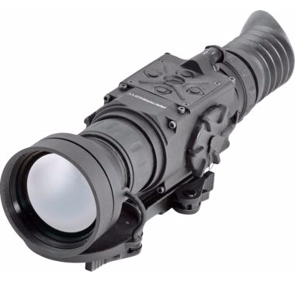
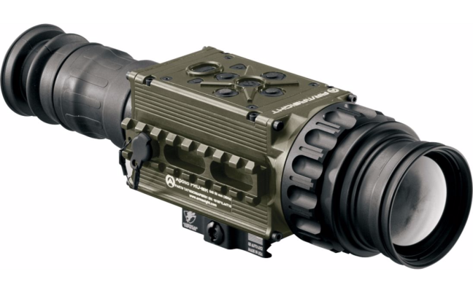
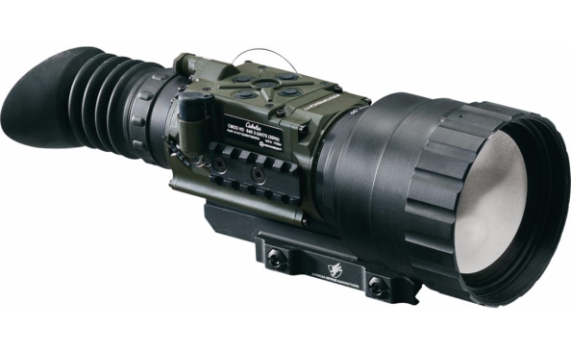
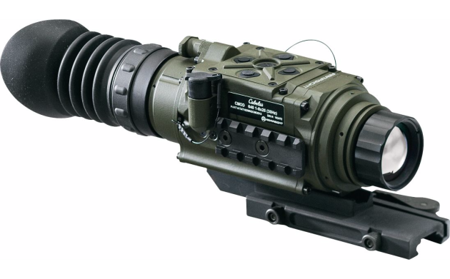
What is current price range?
ThOR (50 mm)
$3500
Overlord (50 mm)
$7900
Zeus (75 mm)
$4800
$$$
Goliath (75 mm)
$7000
Hellhound (25 mm)
$3000
Existing thermal scopes are not affordable for widespread use.
Infrared optics cost is the main limit of the thermal scope use.
High-resolution sensor array may constitute big part of the cost.

Slide 5
Proposed Product
We propose to fill the gap between telescopic sights and thermal vision sights with a novel device, as represented by U.S. Patent No. 9,261,408, entitled Bolometric Infrared Quadrant Detectors and Uses with Firearm Applications.
Proposed device includes special thermal sensor, active (motorized) bipod with support electronics, and optical day/night sight. It provides infantry/marine squads great advantage during crossfire in urban conditions because its Active Bipod System described in the patent is designed to improve the average aiming accuracy of small arms at least three times in both vertical and horizontal direction, and to reduce average aiming time at least twice. It must result in about twenty times better fire efficiency.
The hybrid device doesn’t substitute thermal scopes but is designed to fill the gap between them and ordinary scopes.

Slide 6
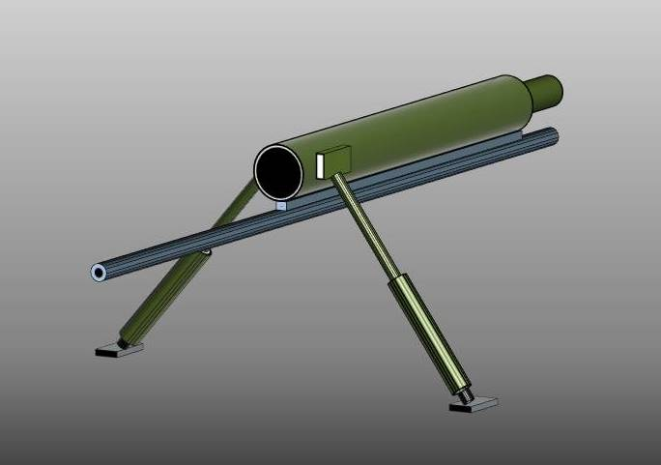
Proposed Product
We propose novel patented device to fill the gap between telescopic sights and thermal sights.
U.S. Patent No. 9,261,408 describes self-guided thermal tracking system attached to small arms (in the picture, to the top of the barrel). It consists of quadrant thermal detector, infrared optics, visible spectral range day/night scope, electronics, and motorized bipod. The system is designed to detect objects having certain temperatures and provide assisted fine aiming via active bipod. Axes of the quadrant detector are 45º tilted to coincide with directions of the motorized bipod legs. Legs are perpendicular to each other and to the barrel, providing fine aiming, while coarse aiming remains manual.
The video presents operation of a prototype tracking system consisting of an array of microbolometers, reflection optics, and custom software, and demonstrates the high potential of the proposed approach. The model simulates a moving 12” large target ( ~ human head size) having temperature of T=35ºC (~human body temperature) in 23ºC (73.4ºF) environment at ~ 220 yards distance from the 3” dia. optics having F=500mm. The prototype system simulates quadrant detector consisting of four 50x50 pixel micro-bolometer arrays (red squares). While low signal-to-noise ratio doesn’t allow quality imaging for a thermal scope, the system provides reliable detection and precise tracking.

Slide 7
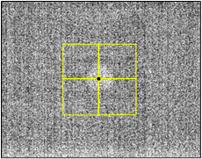
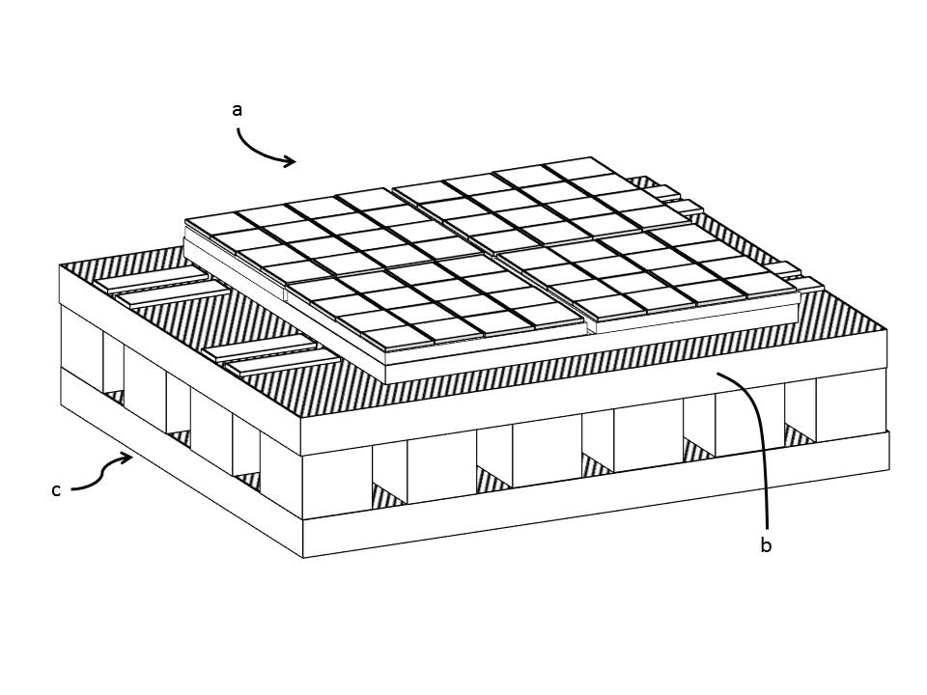
How does it work?
Analysis of the error curve and signal-to-noise curves indicates that for the steady 12” target the system can provide an exceptional precision of the centering of ~0.6” with a corresponding time constant of less than one second, which exceeds capabilities of the majority of best snipers.
Signal averaging over the quadrant area significantly improves signal-to-noise ratio: for the 50x50 pixel quadrant corresponding improvement factor will be 50. This means that such sensor requires much smaller lens: same signal-to-noise ratio can be achieved with 7 times smaller lens.
An additional advantage can be achieved using a thermoelectric cooler to freeze the sensor. Patented design of the sensor makes it analog device and eliminates the need for read-out integrated circuit (ROIC), which is normally located under the focal plane array. This design opens an opportunity to install a small TE cooler instead of ROIC - for further increase of the device sensitivity by reducing detector temperature.

Slide 8
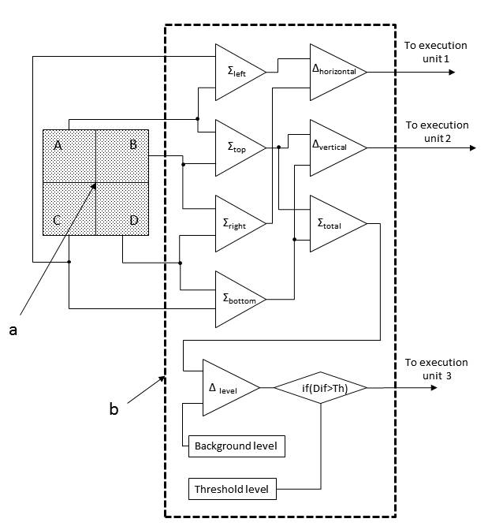
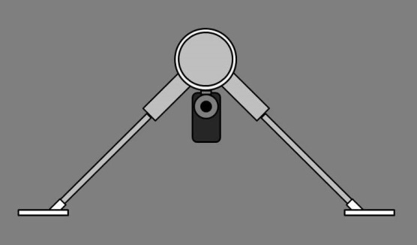
How does it work?
Proposed quadrant detector employs the same sort of sensitive elements (pixels) as are used in modern thermal viewers. However, those elements are connected differently to form quadrants. Eliminating individual access to pixels of the focal plane array allows great simplification of the electronics and a huge reduction in the sensor’s cost.
The design of the proposed quadrant detector is focused on its simplification in order to reduce its cost, to improve its robustness, and to reduce its power consumption. The sensor is an analog device (as a difference from thermal imaging devices). The corresponding tracking system is based on simple operational amplifiers, and there is no need for ROIC /image processing electronics/software.
Proposed design of the device optical system is based not on refraction optics (lenses), but on reflection optics, i.e. main optical element must be a concave mirror. Mirrors are much less expensive than infrared lenses, and also have an additional advantage: they work for visible light as well. This allows building of a hybrid optical system.
Active bipod has motorized legs, and these legs are perpendicular to each other (patented), providing an independent shift of the system axis in corresponding directions via a minor change in the legs length, and thus allows for assisted fine aiming (while the selection of targets and coarse aiming remain manual).

Slide 9
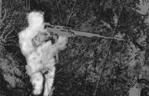
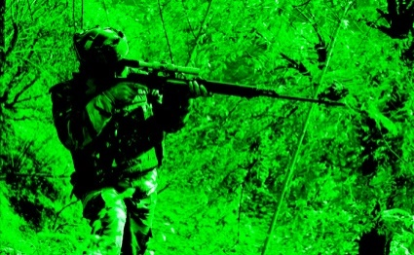
How does it work?
Thermal IR image
Optical + quadrant
Color night vision + quadrant
Night vision + quadrant
No tracking
Tracking
Tracking
Tracking
Simulated images above illustrate view through the thermal scope in comparison with projected views through the hybrid scopes of various configurations. Hybrid scope is not designed to substitute thermal scopes, however, it adds thermal sensing to ordinary scopes for the fraction of the thermal scope cost. In addition, the tracking system is designed to drag the crosshair to the center of a thermal emission, detected by any of four detector quadrants.
The hybrid scope must allow detecting camouflaged targets by their thermal emission via scanning critical areas.
Tracking system drags the crosshair towards the center of detected IR emission
“Thermal image”
Detection by upper quadrant
“Camouflaged sniper detected”

Slide 10
Advantages of proposed technology:
provides infantry/marine squads great advantage during crossfire in urban conditions because its Active Bipod System described in the patent is designed to improve the average aiming accuracy of small arms at least three times in both vertical and horizontal direction, and to reduce average aiming time at least twice. It must result in about twenty times better fire efficiency.
allows quick transfer to mass production, easy certification, and thus, makes the proposed system both affordable and reliable, because the device is based on mature microbolometer technology and simple electronics.
allows cost reduction (up to ten times) comparing with ordinary thermal viewer sights. The device employs hybrid IR/visible telescopic sight with room temperature microbolometer LWIR quadrant detector. Novel technical solution opens an opportunity of heat sensing system which may cost a fraction of an ordinary thermal viewer scope price.
has improved signal-to-noise ratio due to spatial signal averaging. This provides up to seven times better sensitivity and allows reduction of the optics size, thus reducing the system’s weight, dimensions, and improving its robustness.
reduces power consumption. Being an analog device, such detector eliminates the need in Read Out Integrated Circuit (ROIC) and thus reduces power consumption and heat generation, which allows using TE cooler to further improve the device sensitivity. Lower power consumption is essential for reduction of batteries weight and size.
opens new markets. Reduction in optics size (due to improved sensitivity of the detector ) and low power. consumption analog electronics with smaller batteries result in lighter weight which opens an opportunity for using such systems not only with small arms but also in tactical drones and ground unmanned vehicles. Such simple, robust, and easy to operate device may have great potential in the civilian market, too.

Slide 11
Market
Proposed Active Bipod System is aiming to revolutionize small arms by a drastic increase of fire efficiency and reduction in ammo consumption. It is expected to be used widely in coming years.
Total world market of the military active bipod systems based on bolometric quadrant detectors can be estimated as $100 million a year, including new small arms with pre-installed active bipod system, and modernization of existing small arms. U.S. Patent No. 9,261,408, however, covers only a part of the world market: USA, Canada, Europe, and Israel.
Civilian market (for example, scopes for hunting ) will require the corresponding certification and licensing, but it is very promising and may be several times bigger than a military one.
Infrared tracking systems based on bolometric quadrant detectors show great potential in small drones applications, such as tracking cars, humans or animals. This market is currently difficult to estimate, but it has significant chances to burst as small drones become cheaper and get new functions. Separately, one can foresee emerging technology of gliding small caliber heat-guided bombs (which may reduce a collateral damage) employing proposed systems if mass production allows pushing their cost further down.

Slide 12
Competition
There is no direct competition. Proposed technology and design are protected by U.S. Patent No. 9,261,408 in USA, Canada, Europe and Israel. The patent resulted from merging of three provisional patents, covering bolometric quadrant detector, hybrid optical system, and motorized bipod, respectively. This combined patent has 19 claims.
As the proposed system is designed to fill a gap between optical telescopic sights and thermal sights, there is an indirect competition from these sides, and it defines the price range for the proposed product. The top limit is ~$3000 (simplest thermal sight), and the bottom limit is ~$1000 (quality telescopic sight). This price window is sufficient for realization of a hybrid (visible/IR) day sights with thermal sensing and active bipod, as well as for hybrid night sights with thermal sensing and active bipod.
In the market for unmanned aerial vehicles, bolometric quadrant detector based tracking system competes with other ways of tracking objects, for example using a video camera and pattern recognition. Proposed technology may have advantage in the lowest price range – very small tracking drones or even one-off devices, like gliding small caliber heat-guided bombs.

Slide 13
Business Model
Proposed active bipod system based on bolometric quadrant detector has a broad worldwide market and involves mass production in the near future. This means the project can not be completed within a startup company, and at least one of the major manufacturers of infrared devices is expected to acquire the technology. Based on this, we plan parallel work of company subdivisions to maximize the value of the company technology and IP and to prepare for the future transfer of the product to mass production at a site of one of the major producers of applied IR devices.
The business philosophy of SVZ Technologies is the outsourcing of all non-product-specific services to vendors. Every service like machining of mechanical parts, digital electronics design, and programming, device enclosure supply, etc. must have at least two independent vendors to avoid monopoly. Only specific works related to sensor design and assembly, system assembly and testing, order processing, customer service, etc. are done by the company employees.
Detector team
Optics team
Electronics team
Mechanics team
Foundry
Testing team
Marketing team
Transfer team
Patent team

Slide 14
Summary
Engineering company SVZ Technologies comes up with new patented active bipod, which provides infantry/marine squads great advantage during crossfire in urban conditions.
The system described in the patent is designed to improve the average aiming accuracy of small arms at least three times in both vertical and horizontal direction, and to reduce average aiming time at least twice. It must result in about twenty times better fire efficiency.
The system is conceived to fill the gap between thermal scopes and ordinary telescopic sights and is designed to minimize its cost, weight, power consumption, as well as to maximize its robustness.
The novel system employs only mature proven technology.
Transfer to mass production can be done in two years with an investment of ~ $2 Mln.

